Slide 1
Watersheds with possible point source concerns
Oct 2015

Slide 2
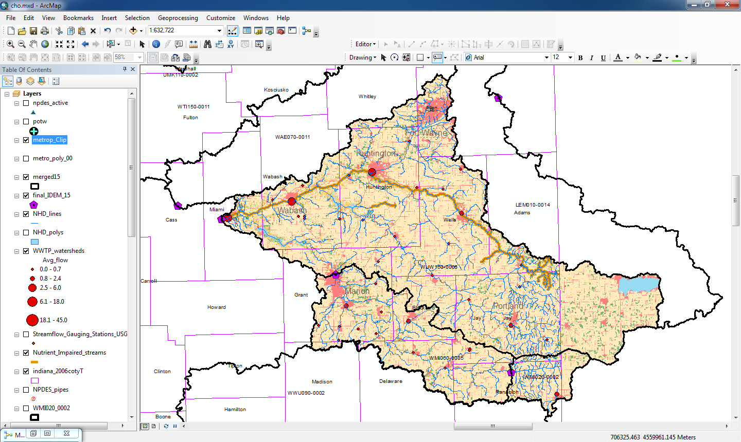
WUW160-0006
40 WWTP yield 22.6 MGD in this watershed
Nutrient impaired river

Slide 3
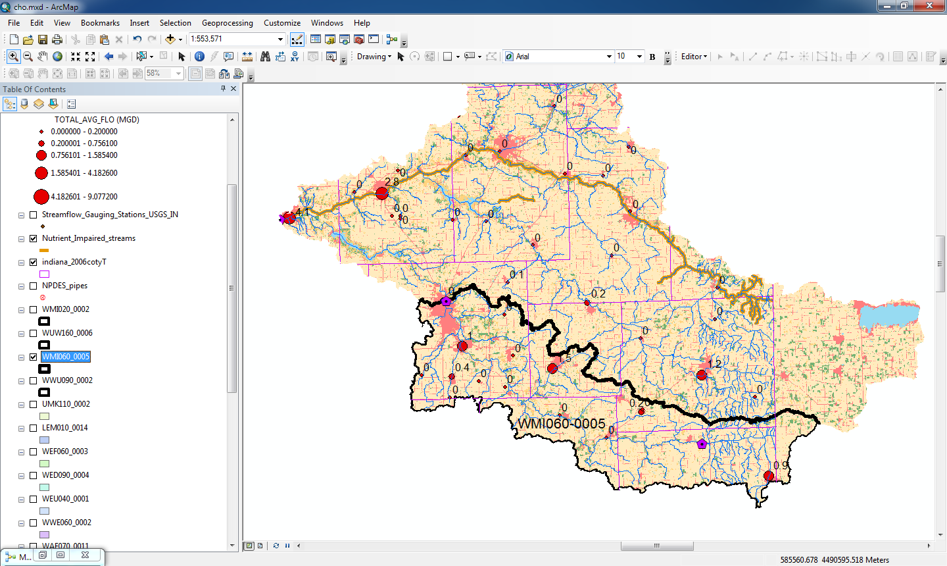
WMI 060-0005
14 WWTP yield 4.5 MGD in this watershed

Slide 4
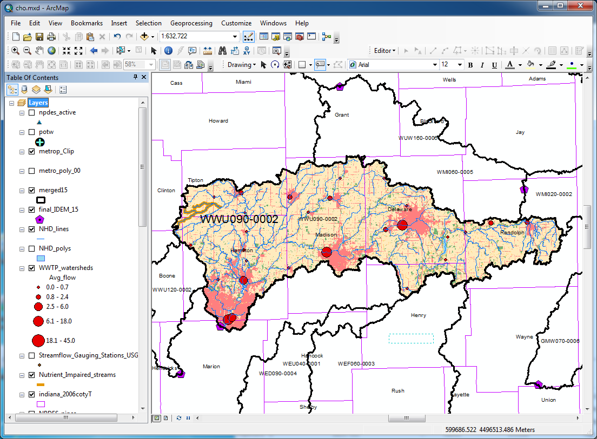
WWU 090-0002
27 WWTP yield 64 MGD in this watershed.

Slide 5
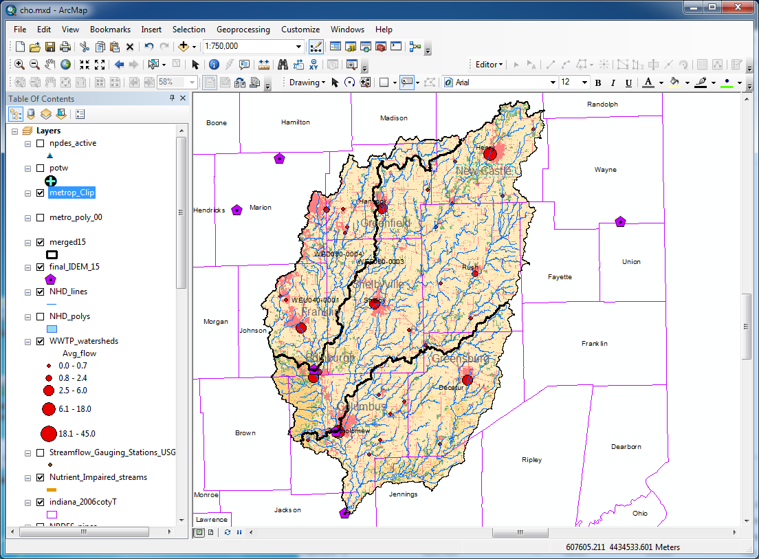
WEU 040-0001
35 WWTP yield 43 MGD in this watershed

Slide 6
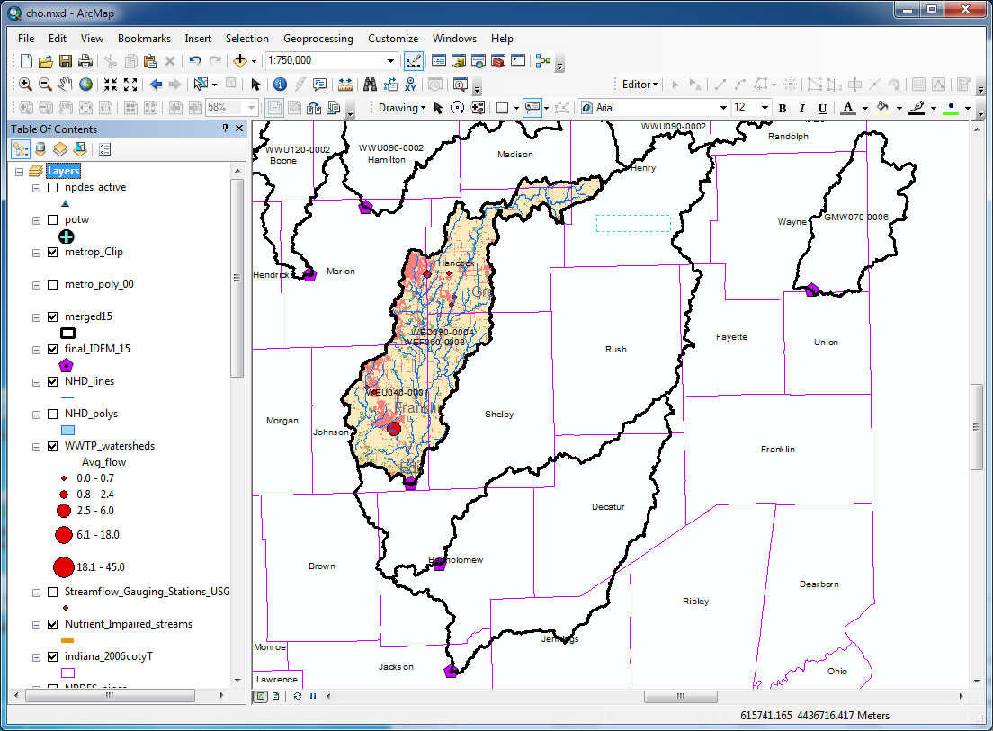
WED 090-0004
7 WWTP yield 6 MGD in this watershed

Slide 7
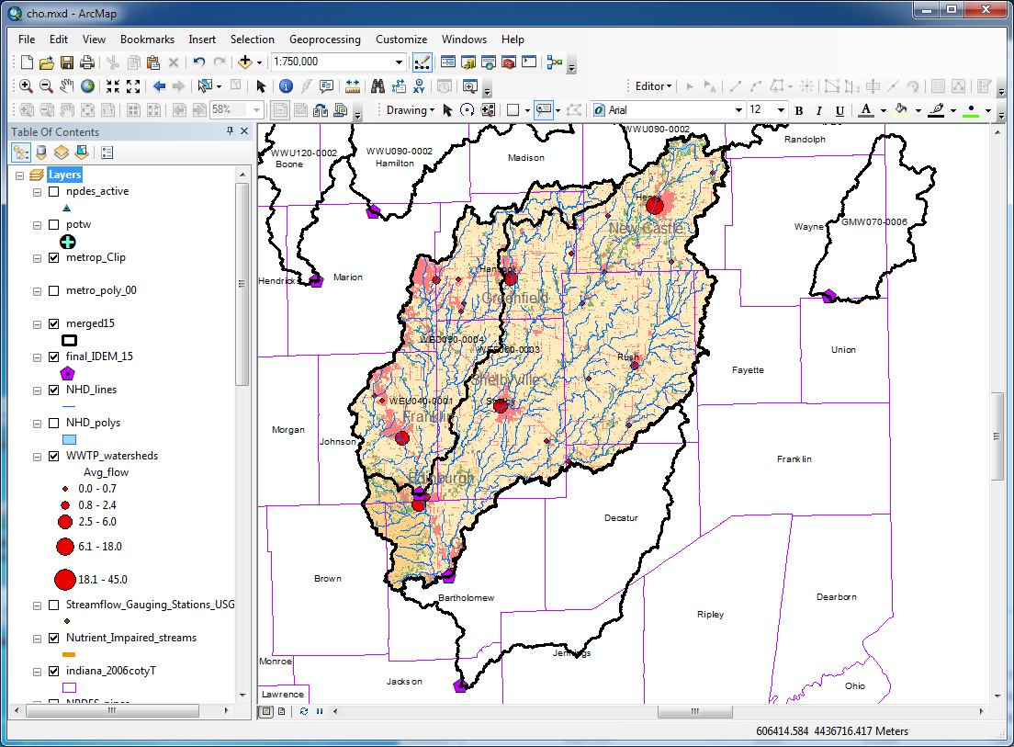
WEF 060-0003
26 WWTP yield 30.2 MGD in this watershed

